Slide 1
LECTURE 3
IP Addressing
MD. ABDUS SATTAR
Assistant Professor
Computer Science &
Information Technology Department
IUT

Slide 2
What is Networking?
  by ‘computer network’ we mean the interconnection between different computers.
Why Networking?
  to share resources:
    hardware (storage, printers etc.) as well as
    software (application programs, data etc.).

Slide 3
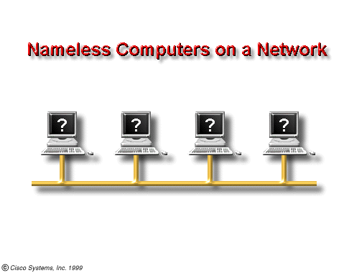

Slide 4
How to differentiate amongst the different, individually similar, computers attached to a network?
  The simple answer to this question is that we can use different names or identifications for each individual computer.

Slide 5
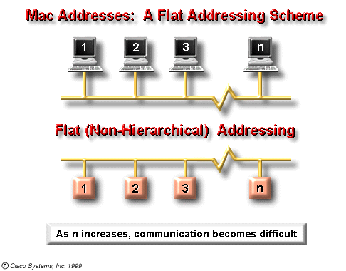

Slide 6
For a large network, finding a standard rule for naming computers will be very difficult.
One simple way of identifying individual computer is to assign an address to each computer, because naming convention may end up in having duplicate names in a large network.

Slide 7
What are the different methods of addressing?
i) MAC Addressing
ii) IP Addressing

Slide 8
MAC Addressing

Slide 9
Every computer has a unique way of identifying itself.
Each computer, whether it is attached to a network or not, has a physical address. No two physical addresses are ever alike.
Referred to as the Media Access Control Address or MAC Address, the physical address is located on the Network Interface Card or NIC Card

Slide 10
MAC addresses are 48 bits in length.
They are expressed as 12 hexadecimal digits.
MAC Addresses are split into two half,
each consisting of 6 hexadecimal digits:
      1st Half is the OUI identifier.
      2nd Half is Card identifier.

Slide 11
The first six hexadecimal digits identify the manufacturer or vendor
These are also known as the
Organizational Unique Identifier (OUI).
These numbers are administered by the IEEE

Slide 12
The last six hexadecimal digits comprise the interface serial number, or another value administered by the specific vendor.

Slide 13
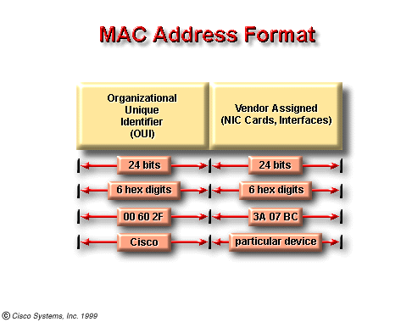

Slide 14
Two formats are used to express MAC address:
    octets 44-AB-5F-DF-C1-FB
    double octets 44AB.5FDF.C1FB
The octet format is generally used.

Slide 15
Advantages of MAC Addressing
MAC addresses are vital to the functioning of a computer network.
They provide a way for computers to identify themselves;
they give hosts a permanent, unique name, and
they are not going to run out anytime soon, since there are 16^12 (over 2 trillion!) possible MAC address names.

Slide 16
Disadvantages of MAC
There is one major disadvantage to MAC addresses.
MAC addresses are flat.
What do we mean by flat?
There is no structure. The different number sections, divided by hyphens do not mean anything.

Slide 17
Disadvantages of MAC
Social Security number is a flat number (987-65-4321).
The different number sections, divided by hyphens do not mean anything.
On the other hand each section of a phone number, however means something:
880- 2- 980 0964
This approach is known as hierarchical addressing

Slide 18
The primary limitation of MAC addressing: it is a flat, non-hierarchical naming system which does not scale well to large numbers of computers.
Since we are interested in internetworking large numbers of computers, another addressing scheme -- imposed at Layer three -- is necessary.

Slide 19
IP Addressing

Slide 20
IP addresses identify a device on a network and the network to which it is attached.
An IP address (in version 4) is represented by a 32 bit binary number.
11000000000001010000010100000001
To make them easy to remember, IP addresses are usually written in dotted‑decimal notation.

Slide 21
We break up the 32 bits of the address into four octets (an octet is a group of 8 bits)
11000000 00000101 00000101 00000001
and each octet is expressed as a decimal number
192 5 5 1
then we put a dot in between the decimal numbers.
  192. 5. 5. 1
Therefore, IP addresses are 4 decimal numbers separated by dots.

Slide 22
IP Address Format
32 bits
→ 8 bits ←
→ 8 bits ←
→ 8 bits ←
→ 8 bits ←

Slide 23
The IP Address is divided in to two component fields
      (i) network number and
      (ii) host number
The network number of an IP address identifies the network to which a device is attached and hence makes the hierarchical addressing, discussed earlier, possible.
The host number of an IP address identifies the specific device on that network.

Slide 24
The network number and the host number make up the IP Address
32 bits
Network# Host#

Slide 25
Because IP addresses consist of four octets separated by dots, one, two, or three of these octets may be used to identify the network number.
Similarly, up to three of these octets may be used to identify the host portion of an IP address.
Depending on how many octets are there in network# identification, networks are classified into different classes

Slide 26
IP Address Classes
There are five classes of IP addresses
They are Class A, B, C, D and E.
Only Class A, B, and C are for public use and is assigned by the American Registry for Internet Numbers (ARIN)
Class D and E are reserved for special use and not allowed for public use

Slide 27
Class A
N
H
H
H
Class B
N
N
H
H
Class C
N
N
N
H

Slide 28
IP Address Classes
ARIN now reserves
Class A addresses for governments throughout the world (although a few large companies, such as Hewlett Packard, have received one in the past)
Class B addresses for medium-sized companies.
Class C addresses for all other requestors

Slide 29
How to identify network classes from the IP Address?
Bits
7
6
5
4
3
2
1
0
Class A
0
N
H
H
H
0-127
Class B
1
0
N
N
H
H
128-191
Class C
1
1
0
N
N
N
H
192-223

Slide 30
# of hosts in different networks
Class A 2²⁴ – 2= 16777214
Class B 2¹⁶ – 2 = 65534
Class C 2⁸ – 2 = 254

Slide 31
Reserved Address Space
Let us consider the following scenario:
  we want to communicate with all of the devices on a separate network,
  it would be quite unmanageable to write out the IP address for each device of that network.
  We might try two hyphenated addresses, indicating that we are referring to all devices within a range of numbers, but that, too, would be quite unmanageable.
  There is, however, a shorter method.

Slide 32
Reserved Address Space
Let us consider another scenario:
  we want to send data to all of the devices on the same network,
  it would be quite unmanageable to write out the IP address for each device of the network.
  We might try two hyphenated addresses, indicating that we are referring to all devices within a range of numbers, but that, too, would be quite unmanageable.
  There is also another shorter method.

Slide 33
Reserved Address Space
An IP address that ends with binary 0s in all host bits is reserved for the network address
Therefore, as a Class A network example, 113.0.0.0 is the IP address of the network containing the host 113.1.2.3.
As a Class B network example, the IP address 176.2.0.0 is a network address.
They will never be used as an address for any device that is attached to these networks.

Slide 34
Reserved Address Space
Similarly an IP address that ends with binary 1s in all host bits is reserved for the broadcast address.
For the network in the example (176.2.0.0), where the last 16 bits make up the host field (or host part of the address), the broadcast that would be sent out to all devices on that network would include a destination address of 176.2.255.255 (since 255 is the decimal value of an octet containing 11111111).
This will never be used as an address for any device that is attached to this network.

Slide 35
Subnetworks or Subnetting
What is a subnetwork or subnet?
  Network administrators sometimes need to divide networks, especially large ones, into smaller networks.
  These smaller divisions are called subnetworks
  Most of the time subnetworks are simply referred to as subnets.
Why Subnetting ?
  to provide addressing flexibility for Network Administrators
  to reduce the size of a broadcast domain.

Slide 36
How are subnets formed?
Subnet addresses are assigned locally, usually by the network administrator. Also, like other IP addresses, each subnet address is unique.
Subnet addresses include the Class A, Class B, or Class C network portion, plus a subnet field and a host field.
The subnet field and the host field are created from the original host portion for the entire network.

Slide 37
Class A
N
SN
H
H
H
Class B
N
N
SN
H
Class C
N
N
N
SN
H

Slide 38
How are subnets formed?
The ability to decide how to divide the original host portion into the new subnet and host fields provides addressing flexibility for the network administrator.
To create a subnet address, a network administrator borrows bits from the original host portion and designates them as the subnet field.

Slide 39
How many bits to borrow?
If we borrow only 1 bit, to create a subnet, then we would have
      a network with number 0 and
      another with network number 1
But we know that these are reserve numbers.

Slide 40
How many bits to borrow?
So, the minimum number of bits that can be borrowed from any class is 2.
The maximum number of bits that can be borrowed can be any number that leaves at least 2 bits remaining, for the host number.

Slide 41
Subnet mask
What is a subnet mask?
  The subnet mask is not an address,
  it determines which part of an IP address is the network field and which part is the host field.
  A subnet mask is 32 bits long just like an IP address.

Slide 42
Subnet mask
How is it created?
To determine the subnet mask for a particular subnetwork IP address follow these steps:
  (1) Express the subnetwork IP address in binary form.
  (2) Replace the network and subnet portion of the address with all 1s.
  (3) Replace the host portion of the address with all 0s.
  (4) As the last step convert the binary expression back to dotted-decimal notation.

Slide 43
Default subnet masks
Class A 255.0.0.0
Class B 255.255.0.0
Class C 255.255.255.0

Slide 44
Why do we need a subnet mask?
Hosts and routers use the ANDing process to determine if a destination host is on the same network or not.
The ANDing operation happens any time a host wants to send a packet to another host on an IP network.

Slide 45
Why do we need a subnet mask?
The result of the 1st AND is to identify the network where the source host resides.
It will then compare the destination IP address to its own subnet mask (2nd AND) to determine the network address of the destination host.

Slide 46
SUBNET MASKS
Host X (Source) on network 200.1.1.0 (Class C Network) has an IP address of 200.1.1.5 and wants to send a packet to Host Z (Destination) on network 200.1.2.0 and has an IP address of 200.1.2.8. All hosts on each network are connected to hubs or switches and then to a router (Remember that with a class C network, ARIN assigns the first 3 octets (24 bits) as the network address, so these are two different networks.
Source (X) Destination (Z)
Host IP 200.1.1.5 200.1.2.8
Network# 200.1.1.0 200.1.2.0
Subnet Mask 255.255.255.0 255.255.255.0

Slide 47
SUBNET MASKS
Host X compares it’s own IP address to its own subnet mask using the ANDing process
Host X IP 200.1.1.5
11001000.00000001.00000001.00000101
SN Mask 255.255.255.0
11111111.11111111.11111111.00000000
ANDing result
11001000.00000001.00000001.00000000
Own network address 200 . 1 . 1 . 0

Slide 48
SUBNET MASKS
Next Host X compares the IP address of the Host Z dest. to its own subnet mask using the ANDing process
Host Z IP 200.1.2.8
11001000.00000001.00000010.00001000
Subnet Mask 255.255.255.0
11111111.11111111.11111111.00000000
ANDing result
11001000.00000001.00000010.00000000
network address 200 . 1 . 2 . 0

Slide 49
SUBNET MASKS
Host X now knows that host Z is not in its Local Area Network (LAN) and it must send the packet to its “Default Gateway” which is the IP address of the router interface of 200.1.1.1 on network 200.1.1.0. The router will then repeat the ANDing process to determine which router interface to send the packet out.

Slide 50
SUBNET MASKS
Source Net 200.1.1.0
Destination Net 200.1.2.0
Subnet Mask 255.255.255.0
Subnet Mask 255.255.255.0
Host X
Router
Hub
Host Z
Hub
Host IP 200.1.1.5
Host IP 200.1.2.8
Router Interface
IP 200.1.1.1
Router Interface
IP 200.1.2.1

Slide 51
?

Slide 52
THANK YOU ALL

